Slide 1
CSE 376 Technical writing & presentation
Presented By
Sourav Bhowmik Joy
Reg – 2019331037
Pulok Saha
Reg - 2019331021
Presented To
Presented To
Dr. Md. Forhad Rabbi
Associate Professor
CSE, SUST
Assoicate Professor

Slide 2
Machine learning

Slide 3
CONTENTS
Introduction
Machine Learning Categories
Supervised Learning
Unsupervised Learning

Slide 4
INTRODUCTION
Machine learning (ML) is the scientific study of algorithms and statistical models that computer systems use to perform a specific task without being explicitly programmed

Slide 5
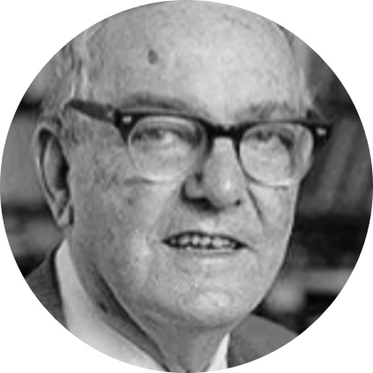
According to Herbert Alexander Simon -
"Learning is any process by which a system improves performance from experience."
"Machine Learning is concerned with computer programs that automatically improve their performance through experience."
Herbert Simon
Turing Award 1975

Slide 6
Machine Learning categories
ML
Supervised Learning
Unsupervised Learning
Semi-supervised Learning
Reinforcement Learning

Slide 7
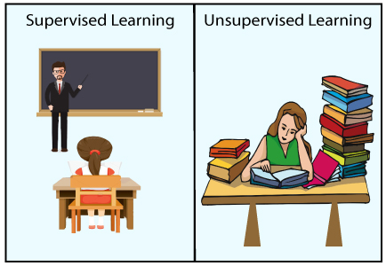
Supervised v/s unsupervised learning

Slide 8
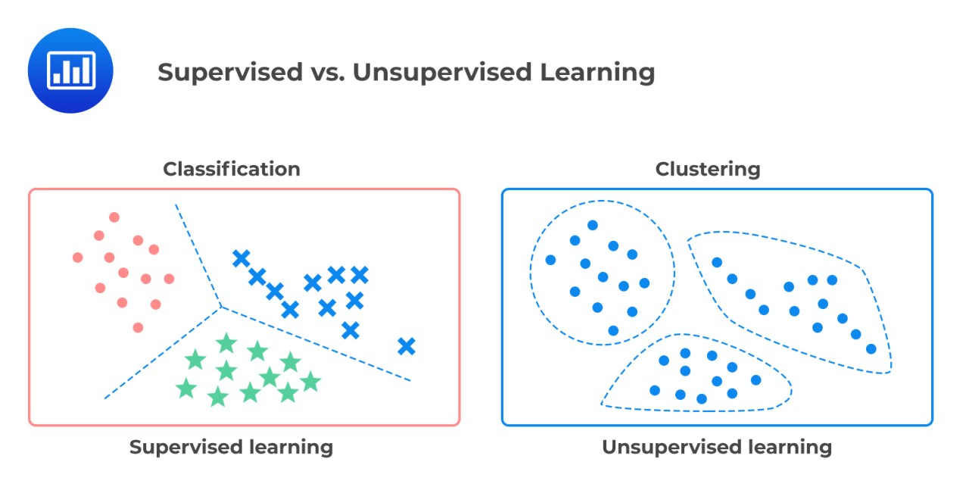
Supervised v/s unsupervised learning

Slide 9
Supervised learning
Supervised learning is a machine learning method in which models are trained using labeled data. In supervised learning, models need to find the mapping function to map the input variable (X) with the output variable (Y)
Y = f (X)

Slide 10
unSupervised learning
Unsupervised learning is another machine learning method in which patterns inferred from the unlabeled input data. The goal of unsupervised learning is to find the structure and patterns from the input data.

Slide 11
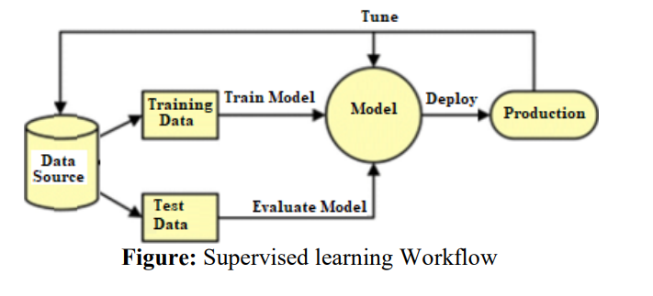
Workflow of supervised learning
Supervised learning can be complicated but getting started doesn’t have to be

Slide 12
Supervised learning algorithms
Decision Tree
Naive Bayes
Support Vector Machine
Supervised Learning

Slide 13
Decision tree
Decision tree is a graph to represent choices and their results in form of a tree. The nodes in the graph represent an event or choice and the edges of the graph represent the decision rules or conditions.

Slide 14
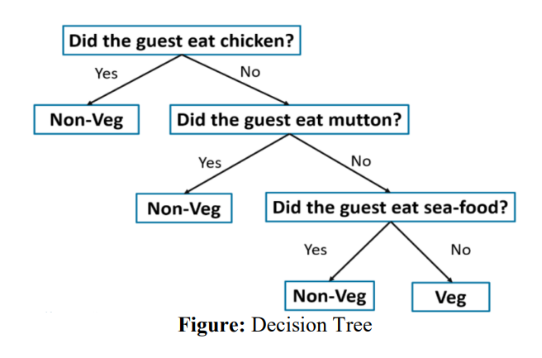
Decision tree

Slide 15
Naïve bayes
It is a classification technique based on Bayes Theorem with an assumption of independence among predictors. In simple terms, a Naive Bayes classifier assumes that the presence of a particular feature in a class is unrelated to the presence of any other feature

Slide 16
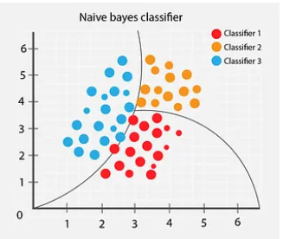
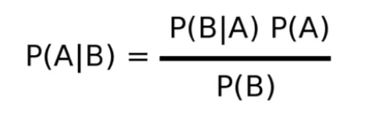
Naïve bayes

Slide 17
Support Vector Machine
Another most widely used state-of-the-art machine learning technique is Support Vector Machine (SVM). In machine learning, support-vector machines are supervised learning models with associated learning algorithms that analyze data used for classification and regression analysis.

Slide 18
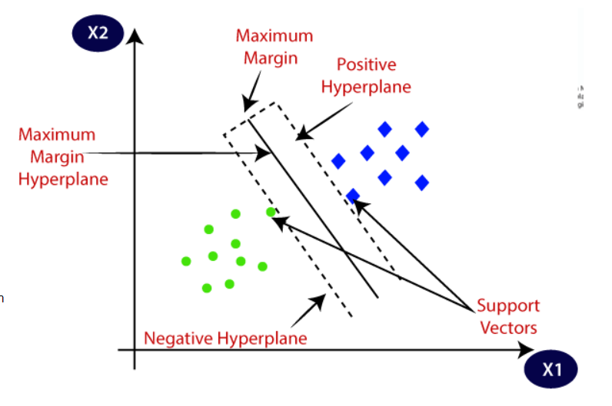
Support vector machine
SVM chooses the extreme points/vectors that help in creating the hyperplane. These extreme cases are called as support vectors, and hence algorithm is termed as Support Vector Machine

Slide 19
Unsupervised learning algorithms
Principal Component Analysis
K Means Clustering
Unsupervised Learning

Slide 20
K means clustering
K-means is one of the simplest unsupervised learning algorithms that solve the well known clustering problem. The procedure follows a simple and easy way to classify a given data set through a certain number of clusters. The main idea is to define k centers, one for each cluster

Slide 21
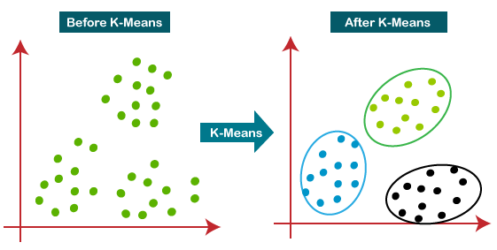
K means clustering

Slide 22
Principal component analysis
Principal component analysis, or PCA, is a dimensionality reduction method that is often used to reduce the dimensionality of large data sets, by transforming a large set of variables into a smaller one that still contains most of the information in the large set.

Slide 23
Principal component analysis

Slide 24
SUMMARY
Machine learning has significant applications in modern world. This slide presents an overview of various popular machine learning algorithms.

Slide 25
THANK YOU

